Slide 1
Sample Live Poll in Presentations
PollQR Example

Slide 2
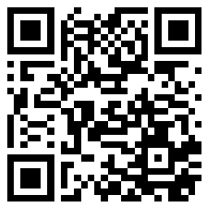
EXAMPLE: What’s your preferred way to learn new material?
SCAN ME NOW TO VOTE
1) Read a book
2) Learn by doing
3) Watch a video
4) Attend a lecture
5) Something else
RESULTS: https://pollqr.com/polls/poll-03174ec2/results

Slide 3
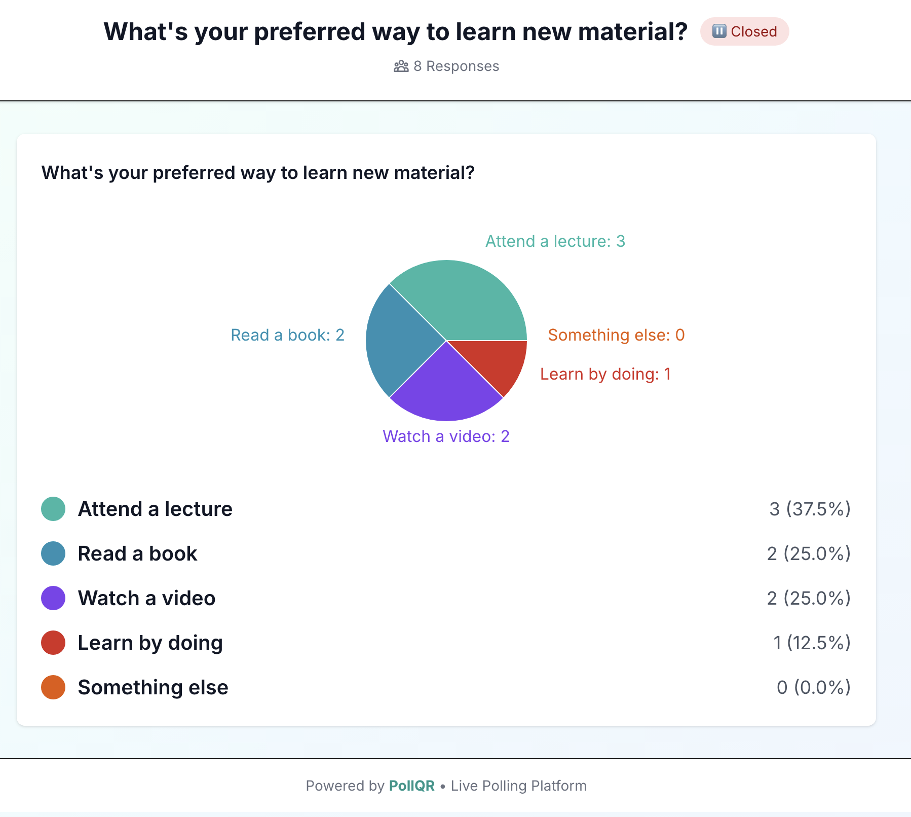

Slide 4
Types of Live Polls on PollQR
YES/NO
RANKING (simple drag and drop to prioritize)
1-5 STAR RATING
WORD CLOUD
MULTIPLE CHOICE

Slide 5
Visit PollQR for more
https://pollqr.com

